Slide 1
CSCI2520 Tutorial Recursion
Pan Zhenyu
zypan24@cse.cuhk.edu.hk
Slide Ack: modified based on the slides from Li Hui

Slide 2
Outline
Recursion
GCD of Two Integers
Hanota Problem

Slide 3
Recursive Functions
A recursive function is a function that makes a call to itself.
Any recursive function will include the following three basic elements.
A test to stop or continue the recursion.
An end case that terminates the recursion.
A recursive call that continues the recursion.
A test to stop or continue
func fact(n):
if n == 0 then
return 1
return n * fact(n-1)
An end case to terminate the recursion
A recursive call to continue recursion

Slide 4
Recursion
Recursion is a method where the solution to a problem depends on solutions to smaller instances of the same problem.
Recursion usually leads to more elegant and simpler solutions, although it incurs larger memory and time overhead.
An important recursive problem-solving skill is divide-and-conquer.
Divide the problem into smaller pieces.
Tackle each sub-task either directly or by recursion.
Combine the solutions of the parts to form the solution of the whole

Slide 5
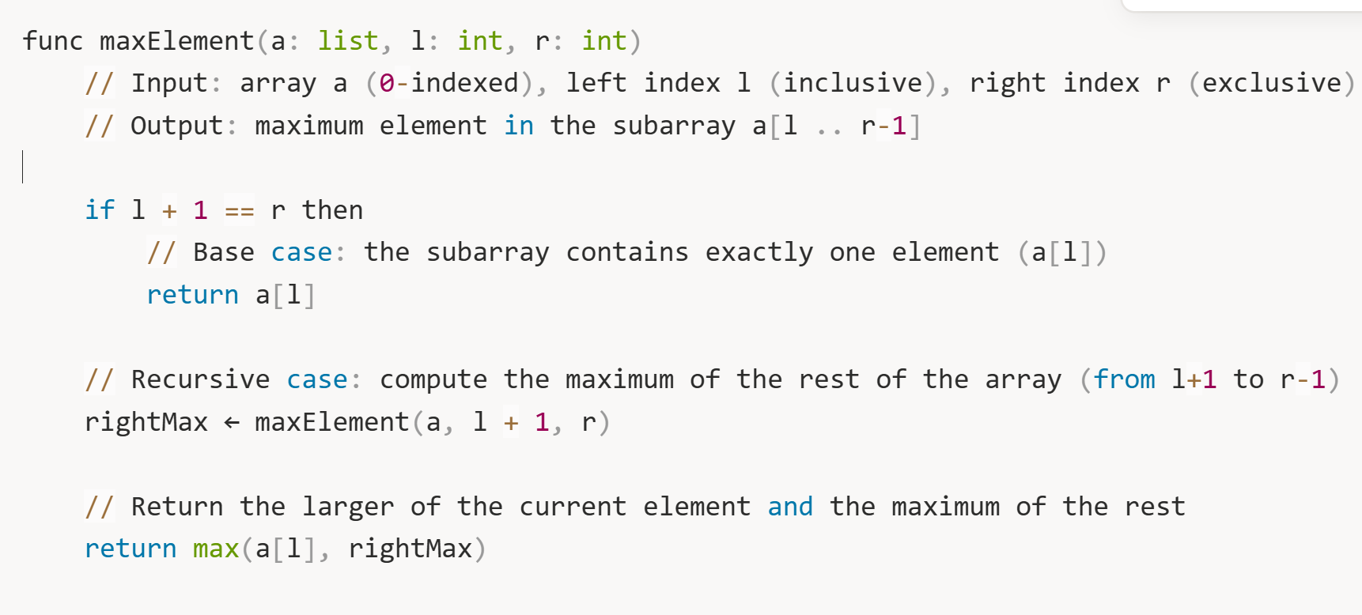
Maximum Element
Please implement a function that return the maximum element inside array a with range [l, r) => max(a[l], a[l+1], …, a[r-1])

Slide 6
Greatest Common Divisor
The greatest common divisor (GCD) of two or more integers, when at least one of them is not zero, is the largest positive integer that divides the numbers without a remainder.
For example, the GCD of 8 and 12 is 4.

Slide 7
GCD of Two Integers
Observation: gcd(a, b) = gcd(a, a+b), because
A common divisor of a and b is also a common divisor of a and a+b
A common divisor of a and a+b is also a common divisor of a and b
Question 1: how to reduce the problem size recursively?
Question 2: what is the end case?

Slide 8
GCD of Two Integers
End case
gcd(a, 0) = a
Recursive call
Assume without loss of generality that a>b
Version 1: gcd(a, b) = gcd(b, a-b)
Version 2: gcd(a, b) = gcd(b, a%b)
For example, gcd(48, 18) = gcd(18, 12) = gcd(12, 6) = gcd(6, 0) = 6

Slide 9
Exercise 1
Finish the implementation of the following function which calculates the GCD of two positive integers.
Hint: what if a<b?
func GCDOfTwoNum(a: int, b: int);

Slide 10
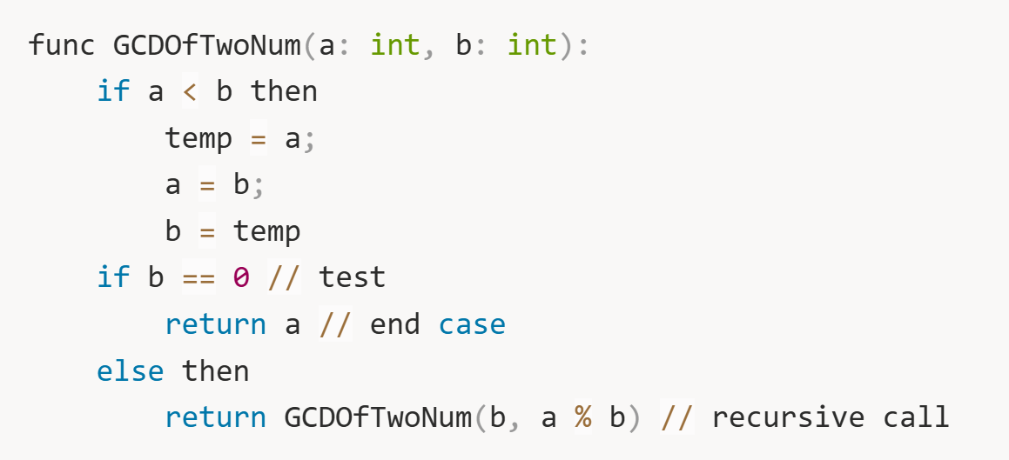
Exercise 1 Solution

Slide 11
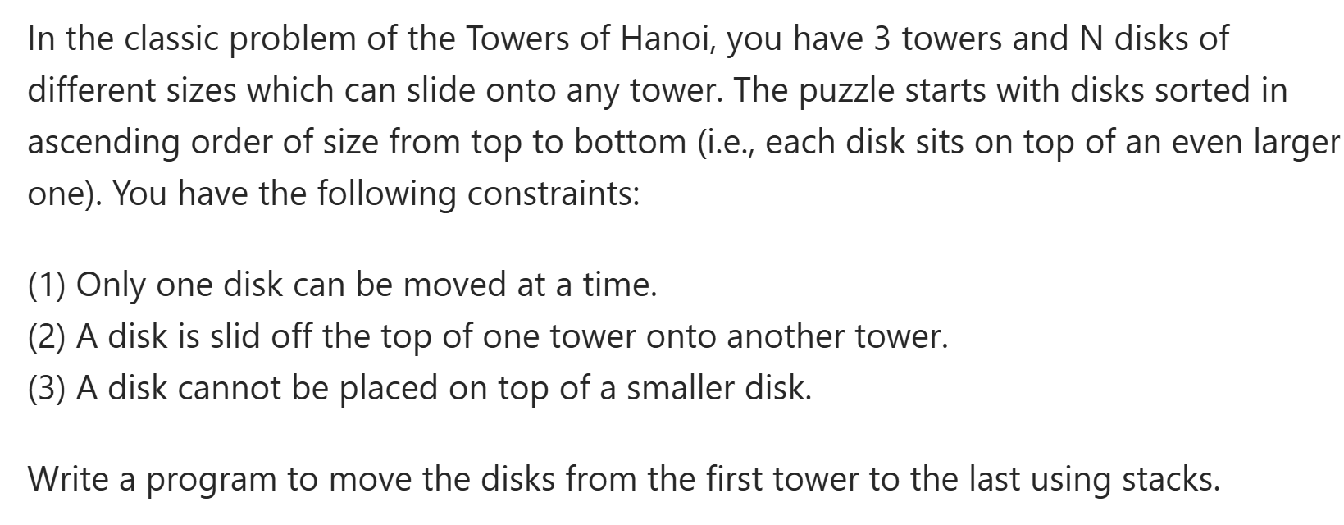
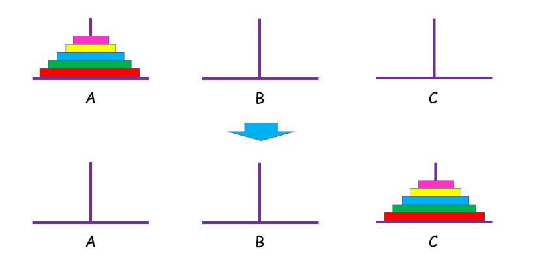
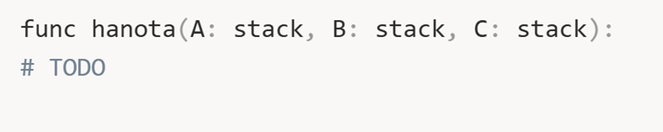
Hanota Problem

Slide 12
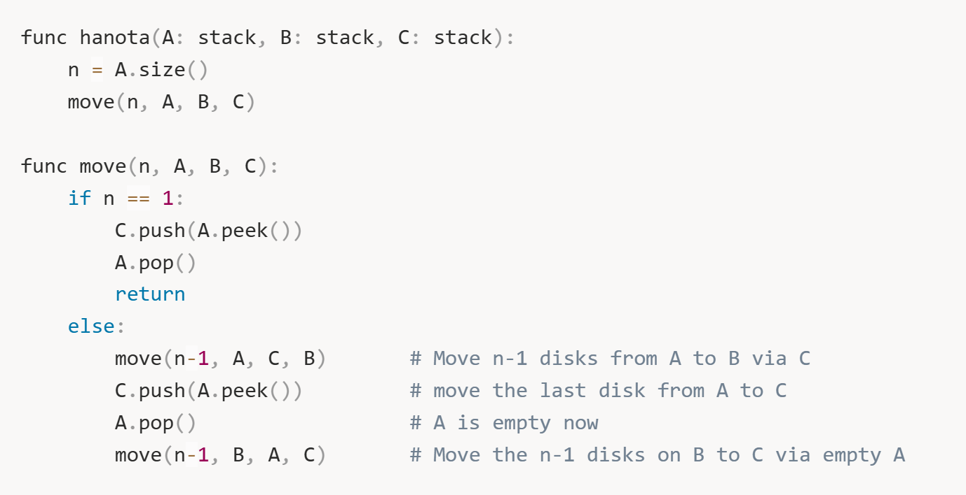
Hanota Problem Solution

Slide 13
Summary
Recursion
GCD of Two Integers
Hanota Problem

